Slide 1
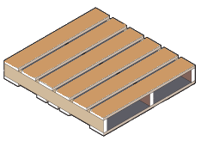
Custom Packaging Products
Food Grade Pallet Process
JULY 8th 2016

Slide 2
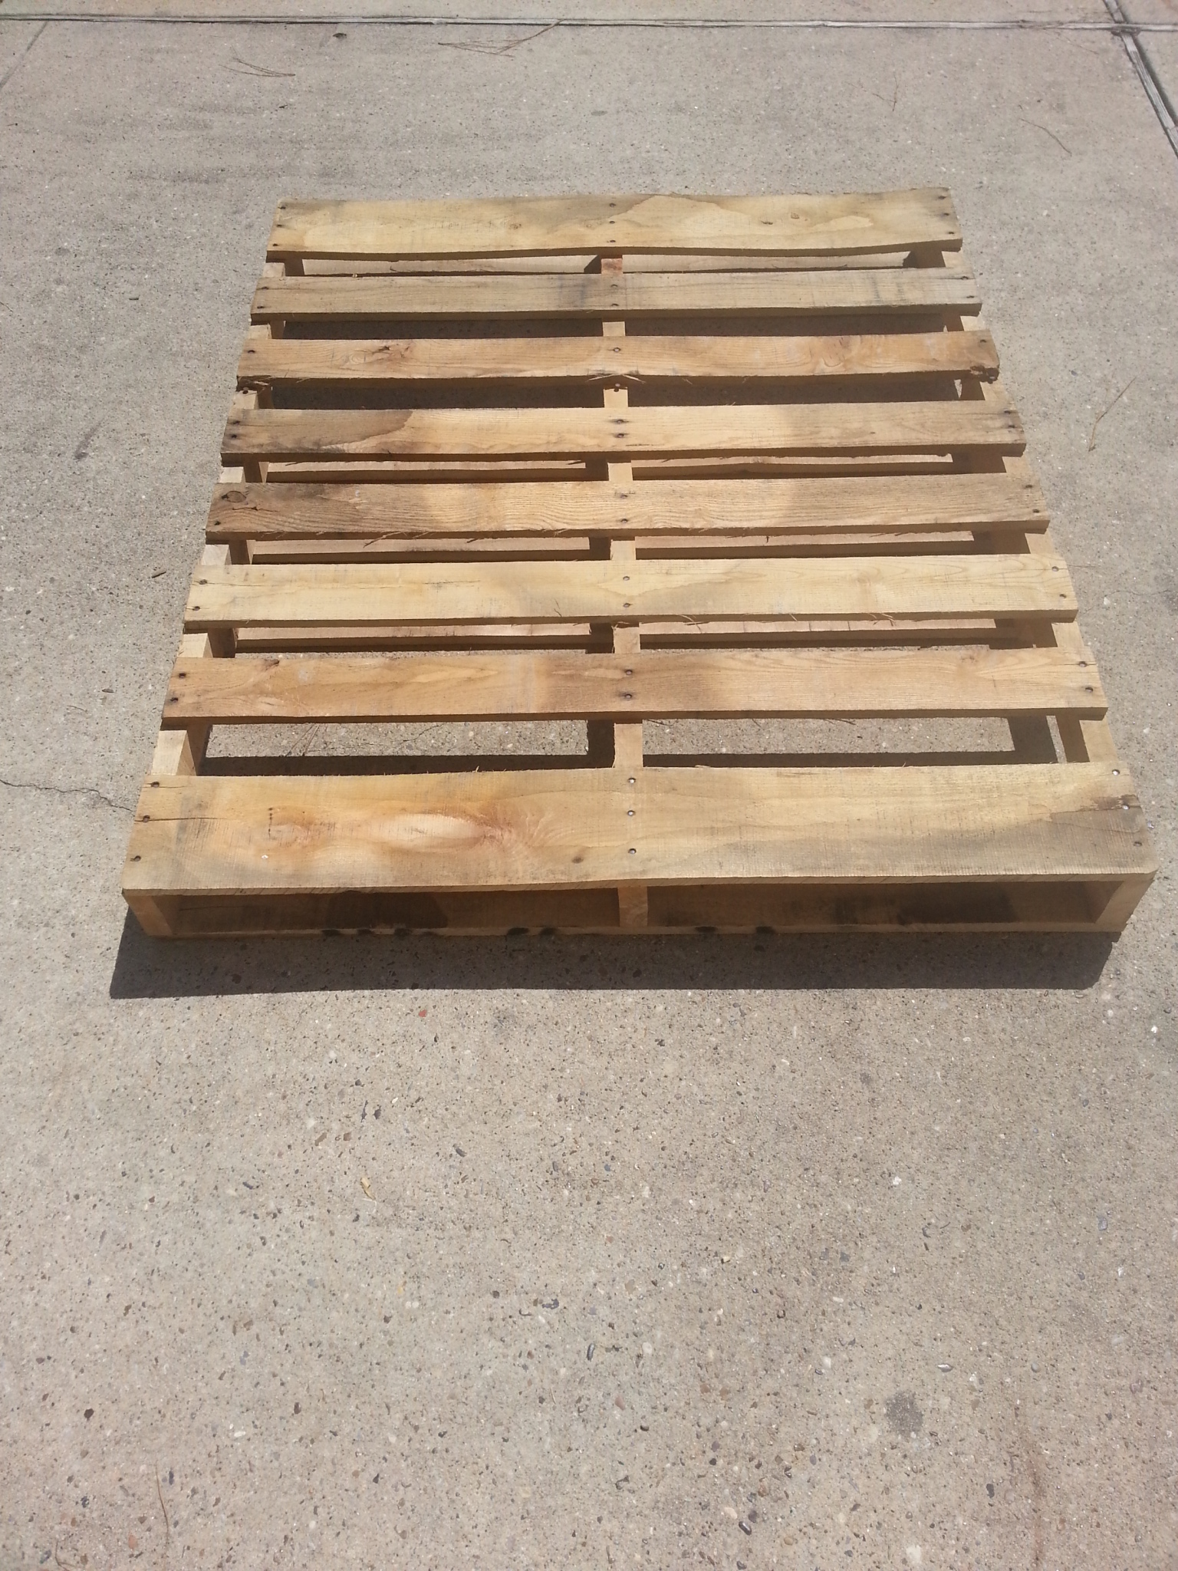
Grade A GMA Pallets
Custom Packaging Products

Slide 3
5 Stage FOOD Grade Process
Stage 1
Sort
Store
State 3
Wash
State 4
State 5
Heat Treat
Ship
Stage 2
Pallets are received and sorted based on grade
Then stored in an enclosed warehouse
Once an order is received, the pallets are washed
If required, they are then sent to the heat treating chamber
Once heat treating is done, they are stored on an outbound trailer
Custom Packaging Products

Slide 4
Quality Control
Initial Review
Washing Inspection
Loading Inspection
Final Inspection
All pallets are reviewed when received for food grade acceptance
Another review is conducted when washing
A third review is done when loading
A final review is done by warehouse manager before shipping
Custom Packaging Products

Slide 5
Cost incurred from unfit pallets
Pallets Not Built Correctly or Infested with Bugs, Dirt, Etc.
Broken Pallets
Contaminated Pallets
When Wrong Pallets are Used
Re-stacking Whole Pallets of Bags
Complete Load Sent Back
Increased Tangible and Intangible Costs
Labor Costs, Product Waste
Freight Costs, Lost Customers
* Studies have shown that tens of thousands of dollars are lost each year from using the wrong pallets

Slide 6
Customer Service
After pallets are delivered, we will do site visits to ensure everything is acceptable
Throughout our relationship, we will always be available to answer any questions or deal with any issues
If they are not right, we will replace them at no charge
Custom Packaging Products

